Slide 1
SELECT Command II
Week 3 – COMP 3002

Slide 2
Null values
Open AdventureWorks database and execute the command:
SELECT * FROM Person.Person
Can you see NULL values in your database?

Slide 3
What is NULL?
The NULL keyword means “undefined”
NULL is distinct from 0 or 0.0, an empty string ( ‘’ ), or a blank string ( ‘ ‘ )
The SQL NULL is the term used to represent a missing value.
A NULL value in a table is a value in a field that appears to be blank.
A field with a NULL value is a field with no value.
It is very important to understand that a NULL value is different than a zero value or a field that contains spaces.

Slide 4
SET CONCAT_NULL_YIELDS_NULL (Transact-SQL)
By default expressions involving NULL evaluate to NULL
This behavior can be turned off and on:
SET CONCAT_NULL_YIELDS_NULL OFF
SET CONCAT_NULL_YIELDS_NULL ON
PRINT 'Setting CONCAT_NULL_YIELDS_NULL ON';
GO
-- SET CONCAT_NULL_YIELDS_NULL ON and testing. The default setting for SQL
SET CONCAT_NULL_YIELDS_NULL ON;
GO
SELECT 'abc' + NULL ;
GO
-- SET CONCAT_NULL_YIELDS_NULL OFF and testing.
SET CONCAT_NULL_YIELDS_NULL OFF;
GO
SELECT 'abc' + NULL;
GO
Execute the code
Find the error in the code

Slide 5
IS NULL
Use IS NULL in the WHERE clause to select rows with NULL values:
USE AdventureWorks2014 ;
SELECT FirstName, LastName, title
FROM Person.Person
WHERE title is null;
SELECT TOP 10 FirstName, LastName, title
FROM Person.Person
WHERE title is null;
SELECT TOP 10 FirstName, LastName
FROM Person.Person
WHERE title is null;
SELECT TOP 10 FirstName, LastName
FROM Person.Person
WHERE title is null
order by LastName
Notes:
SELECT city + ProvinceCode FROM person WHERE provinceCode = null
Vs
SELECT city + ProvinceCode FROM person WHERE provinceCode IS NULL

Slide 6
IS NOT NULL
USE AdventureWorks2014 ;
SELECT FirstName, LastName, title
FROM Person.Person
WHERE title is not null;
Use IS NOT NULL in the WHERE clause to select rows with non-NULL values.
SELECT TOP 10 FirstName, LastName, title
FROM Person.Person
WHERE title is not null;
SELECT TOP 10 FirstName, LastName
FROM Person.Person
WHERE title is not null;
SELECT TOP 10 FirstName, LastName
FROM Person.Person
WHERE title is not null
order by LastName
Notes:
SELECT city + ProvinceCode FROM person WHERE provinceCode IS NOT NULL

Slide 7
NULL AND =, !=
You CANNOT use:
= NULL instead of IS NULL
!= NULL instead of IS NOT NULL
Try it:
SELECT TOP 10 FirstName, LastName
FROM Person.Person
WHERE title = null
order by LastName
Notes:
SELECT city + ProvinceCode FROM person WHERE provinceCode != NULL

Slide 8
IN
Instead of OR
you can use IN :
select FirstName, LastName
FROM Person.Person
WHERE FirstName = 'Hazem' or FirstName = 'Humberto' or FirstName = 'sam'
select FirstName, LastName
FROM Person.Person
WHERE FirstName IN ('Hazem', 'sam','Humberto');
Notes:
--change someone to just Jon
UPDATE person
SET firstname='Jon'
WHERE number=1622877;

Slide 9
IN
IN is preferred when you are working with more than two values:
WHERE state IN ( ‘CA‘ , ‘CO’, ‘NV’ )

Slide 10
BETWEEN ... AND
Instead of >= AND <= …
you can use BETWEEN … AND
SELECT *
FROM Sales.SalesTaxRate
WHERE TaxRate >= 8 AND TaxRate <= 9 ;
SELECT *
FROM Sales.SalesTaxRate
WHERE TaxRate BETWEEN 8 AND 9 ;
Notes:
SELECT number, lastname, firstname
FROM person
WHERE number >= 1176262 AND number <= 1261148
--or
SELECT number, lastname, firstname
FROM person
WHERE number BETWEEN 1176262 AND 1261148

Slide 11

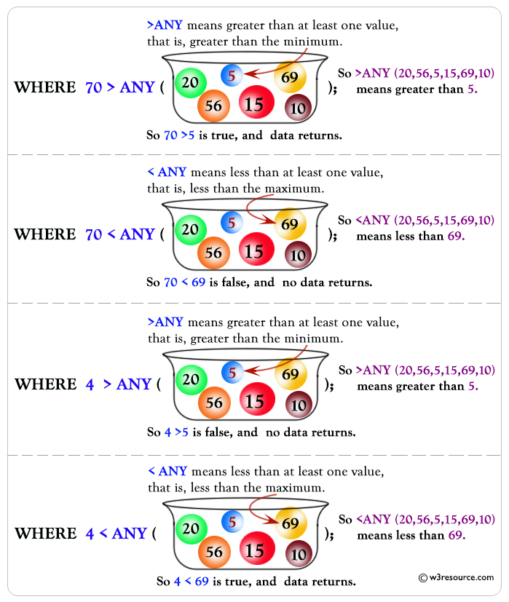
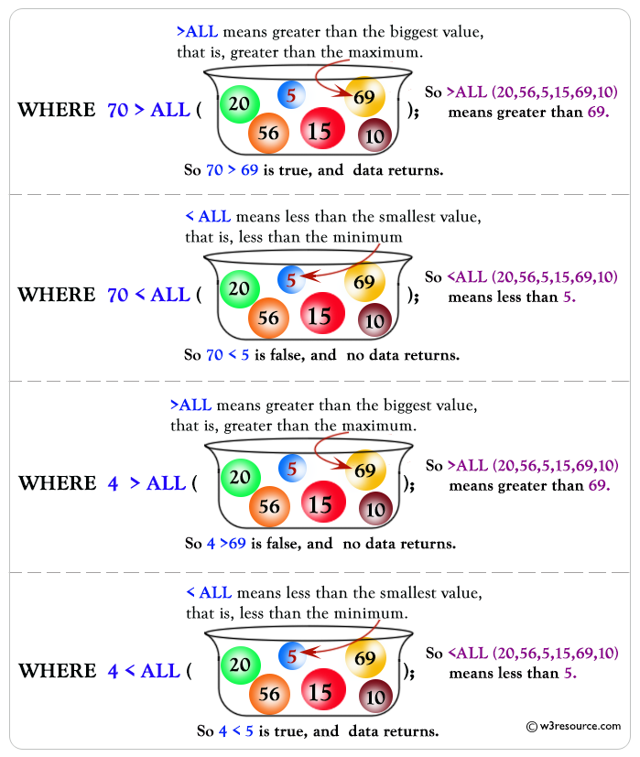
ALL Keyword
The ALL operator returns TRUE if all of the subquery values meet the condition.
The ANY operator returns TRUE if any of the subquery values meet the condition.

Slide 12
LIKE
Use LIKE to perform basic pattern matching.
Literal characters must be present in the given position.
SELECT * FROM [Sales].[Store]
WHERE name like 'Retreat Inn';
Notes:
SELECT number, lastname, firstname
FROM person
WHERE firstName like 'Mary‘
--then update one of them to Maryanne

Slide 13
LIKE
Underscore( _ ) matches one character in the given position
SELECT * FROM [Sales].[Store]
WHERE name like 'Retreat _nn';
Underscore
Notes:
SELECT number, lastname, firstname
FROM person
WHERE firstName like 'Mar_'

Slide 14
LIKE
Percent ( % ) matches zero, one or more characters starting with the given position.
SELECT * FROM [Sales].[Store]
WHERE name like 'Retreat%';
Notes:
SELECT number, lastname, firstname
FROM person
WHERE firstName like 'Mar%'

Slide 15
LIKE
You can repeat and combine % and _ as needed
SELECT * FROM [Sales].[Store]
WHERE name like '%treat%';
Notes:
SELECT number, lastname, firstname
FROM person
WHERE firstName like '%Mar'

Slide 16
NOT (again)
Remember that you can use NOT with the operators just discussed:
...NOT IN
...NOT BETWEEN ... AND
...NOT LIKE
SELECT * FROM [Sales].[Store]
WHERE name NOT like '%a%' AND name NOT LIKE '%E%';

Slide 17
Date Arithmetic
A number of days can be added to a DATETIME column with “+”
select SalesOrderID, OrderQty, ModifiedDate, ModifiedDate + 10
FROM Sales.SalesOrderDetail
ORDER BY OrderQty;
Notes:
Use the payment table
SELECT transactionDate + 7 AS [One Week Later]
FROM Payment
ORDER BY transactionDate;

Slide 18
Date Arithmetic
A number of days can be subtracted from a DATETIME column with “-”
select SalesOrderID, OrderQty, ModifiedDate, ModifiedDate - 10
FROM Sales.SalesOrderDetail
ORDER BY OrderQty;

Slide 19
CASTing Dates
Because a date is returned, output from date arithmetic can be confusing:
Result:
1918-09-17 22:04:41.360
SELECT GETDATE() - '2000-01-01'
AS 'Days since the millennium'
Notes:
SELECT GETDATE() - '2001-01-01' AS [Days Since Millenium];

Slide 20
CASTing Dates
Sometimes it helps to CAST the result to INT:
SELECT CAST( GETDATE() - '2000-01-01' AS INT ) AS 'Days since the millennium'
Result: 6834
SELECT 9.5 AS Original,
CAST(9.5 AS int) AS int,
CAST(9.5 AS decimal(6,4)) AS decimal;
Notes:
SELECT CAST( GETDATE() - '2000-01-01' AS INT )
AS 'Days since the millenium'

Slide 21
Summery
Questions
Videos
Exercise

